Slide 1
Cyber Security: Protecting Against Keylogger Intrusions
CAPSTONE PROJECT
Presented By:
E.Christopher jacob– Jayaraj annapackiam csi college of engineering – B.Tech(IT)

Slide 2
OUTLINE
Problem Statement
System & Iphone Approach
Algorithm & Deploymen
Types of keyloggers
Working
Detecion
Keylogger Python Script
Output
Protection
Future scope
Result
conclusion

Slide 3
Problem Statement
In today's digital age, where cybersecurity threats loom large, one of the significant concerns is the proliferation of keyloggers, stealthy software tools designed to monitor and record keystrokes on a user's computer without their knowledge. Keyloggers are hardware or software that track and record your keystores , then sendteh information to a hacker. They can be used for identity theft and credemtial theft. Here are some ways to protected against keylogger intrusion.

Slide 4
System Approach
Unknown Processes Consuming Computing Power
Like all types of software, keyloggers need to initiate a process in order to work. Each process your computer has to execute requires processing power. A keylogger's process, once initiated, can be a drain on your computing power. This may result in other applications not running the way they normally would or should. You can figure out which processes are running by pulling up the task manager, as described above in "How to Detect a Keylogger."
Delays During Typing
. Because a keylogger positions itself between the keyboard and the monitor, one sign of a keylogger may be a delay
when you type. If you typically see letters, numbers, or symbols appear on your screen immediately after you hit each key but then you notice a slight delay, that could be a sign that a keylogger is interrupting the process.
In some cases, the delayed typing may be due to circumstances like not enough random access memory (RAM), but if you notice this symptom, it may be a good idea to check for keyloggers.
Applications Freeze Randomly
As a keylogger does its work, it may interrupt normal application processing. This can cause the application to freeze without warning. If your applications are freezing more than

Slide 5
Iphones and android approaches
While there may not be any hardware keyloggers designed to attack mobile devices, Androids and iPhones can still be compromised by software keyloggers. These work by capturing where on the screen the user presses or taps, which allows the keylogger to see the virtual buttons pressed while the owner types. The data is then recorded and reported to a hacker.
The threat may be even worse with these forms of keyloggers because they do more than merely monitor and record keystrokes. They can also record screenshots, things picked up by the camera, the
activity of connected printers, what goes into the microphone, and network traffic. A keylogger even has the ability to prevent you from going to certain websites.
To get a keylogger onto a mobile device, a hacker only needs to access it for a short period of time. You can also unintentionally install a keylogger on your device by clicking on a link or attachment.

Slide 6
Algorithm & Deployment
Algorithm for Detecting and Mitigating Keyloggers:
Monitoring System Activities:
Implement a system to continuously monitor processes and activities on the user's computer.
Track changes in system behavior that could indicate the presence of keylogging software.
Signature-based Detection:
Maintain a database of known keylogger signatures and patterns.
Regularly update the signature database to include new threats.
Scan system files and processes for matches with known keylogger signatures.
Real-time Monitoring:
Implement real-time monitoring tools to detect keylogger activities as they occur.
Generate alerts or notifications when potential keylogger activity is detected.
Deployment Plan:
System Integration:
Integrate the keylogger detection algorithm into existing security software or deploy it as a standalone solution.
Ensure compatibility with different operating systems and software environments.
Installation and Configuration:
Deploy the detection software across all endpoints within the organization, including computers, laptops, and mobile devices.
Configure the software to perform regular scans and real-time monitoring according to organizational policies.
Training and Awareness:
Provide training sessions to IT staff and end-users on how to use and interpret the keylogger detection tools effectively.
Raise awareness about the risks posed by keyloggers and the importance of maintaining vigilance against such threats.

Slide 7
Types of key loggers
Two main types of keyloggers are available.
Hardware-based keyloggers
A hardware-based keylogger is a small device that serves as a connector between the keyboard and the computer. The device is designed to resemble an ordinary keyboard PS/2 connector, part of the computer cabling or a USB adapter, making it relatively easy for someone who wants to monitor a user's behavior to hide the device.

Slide 8
Software based keyloggers
A keylogging software program does not require physical access to the
user's computer for installation. It can be purposefully downloaded by someone who wants to monitor activity on a particular computer, or it
can
be malware downloaded unwittingly by the user of the keyboard and its
device, and then executed as part of
a rootkit or remote
administration Trojan. Either way, keylogging software allows an
unauthorized threat actor
to view the user's
keystrokes, and then use this knowledge to access and compromise the device.
There are two main types of software keyloggers:

Slide 9
User mode keyloggers
use a Windows application programming interface (API) to intercept keyboard and mouse movements. GetAsyncKeyState or GetKeyState API functions might also be
captured. These keyloggers require the attacker to actively monitor each key press.
Kernel mode keyloggers:
it is a more powerful and complex software keylogging method. They work with higher
privileges and can be harder to locate in a system. In addition, they can modify the internal Windows system through the kernel. Some keylogging software can use keyboard APIs to run another application, malicious script injection memory injection.

Slide 10
working
A hardware keylogger might come in the form of a module installed inside the keyboard itself. When the user types on the keyboard, the keylogger collects each keystroke and saves it as text stored on its own hard drive, which can have a memory capacity up to several gigabytes.
The person who installed the keylogger must physically remove the device to access the gathered information. There are also wireless keylogger sniffers that can intercept and decrypt data packets transferred between a wireless keyboard and its receiver. A common software keylogger consists of two files that get installed in the same directory:
A dynamic link library file that does the recording, and an executable file that installs the DLL file and triggers it.

Slide 11
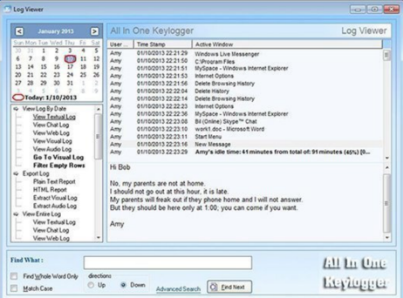
working
The keylogger program records each keystroke the user types and periodically uploads the information over the internet, where the hacker can then access it.
Some keylogging programs can also include functionality to record user data besides keystrokes, such as capturing anything that has been copied to the clipboard and taking screenshots of the user's screen or a single application.

Slide 12
detection
An anti-keylogger is a program designed specifically to scan for software-based keyloggers.
These programs work by comparing the files on a computer against a keylogger signature base or a checklist of common keylogger attributes. Using security software such as an anti-keylogger can be more effective than an antivirus or antispyware program.
The latter could incorrectly identify a keylogger as a legitimate program instead of spyware.
That said, an antispyware application might be able to locate and disable keylogger software with lower privileges than it has.

Slide 13
detection
Using a network monitor will ensure the user is notified each time an application tries to make a network connection, giving a security team the opportunity to stop any possible keylogger activity.
Checking the system's Task Manager can also help with the detection of a keylogger.
However, since keyloggers can manipulate an operating system kernel, examining the Task Manager isn't necessarily enough to detect a keylogger, so it's better to use an anti-keylogger.

Slide 14
KEYLOGGER PYTHON SCRIPT:
In today's digital age, keyloggers are a major cybersecurity concern. These stealthy software tools silently record keystrokes on users' computers, capturing sensitive information like passwords and credit card details without their knowledge. This poses serious risks such as identity theft and financial loss. Despite being hard to detect, individuals and organizations can mitigate this threat by using robust antivirus software, practicing good security habits, and employing advanced security measures like endpoint detection and response solutions

Slide 15

Python code implementation

Slide 16
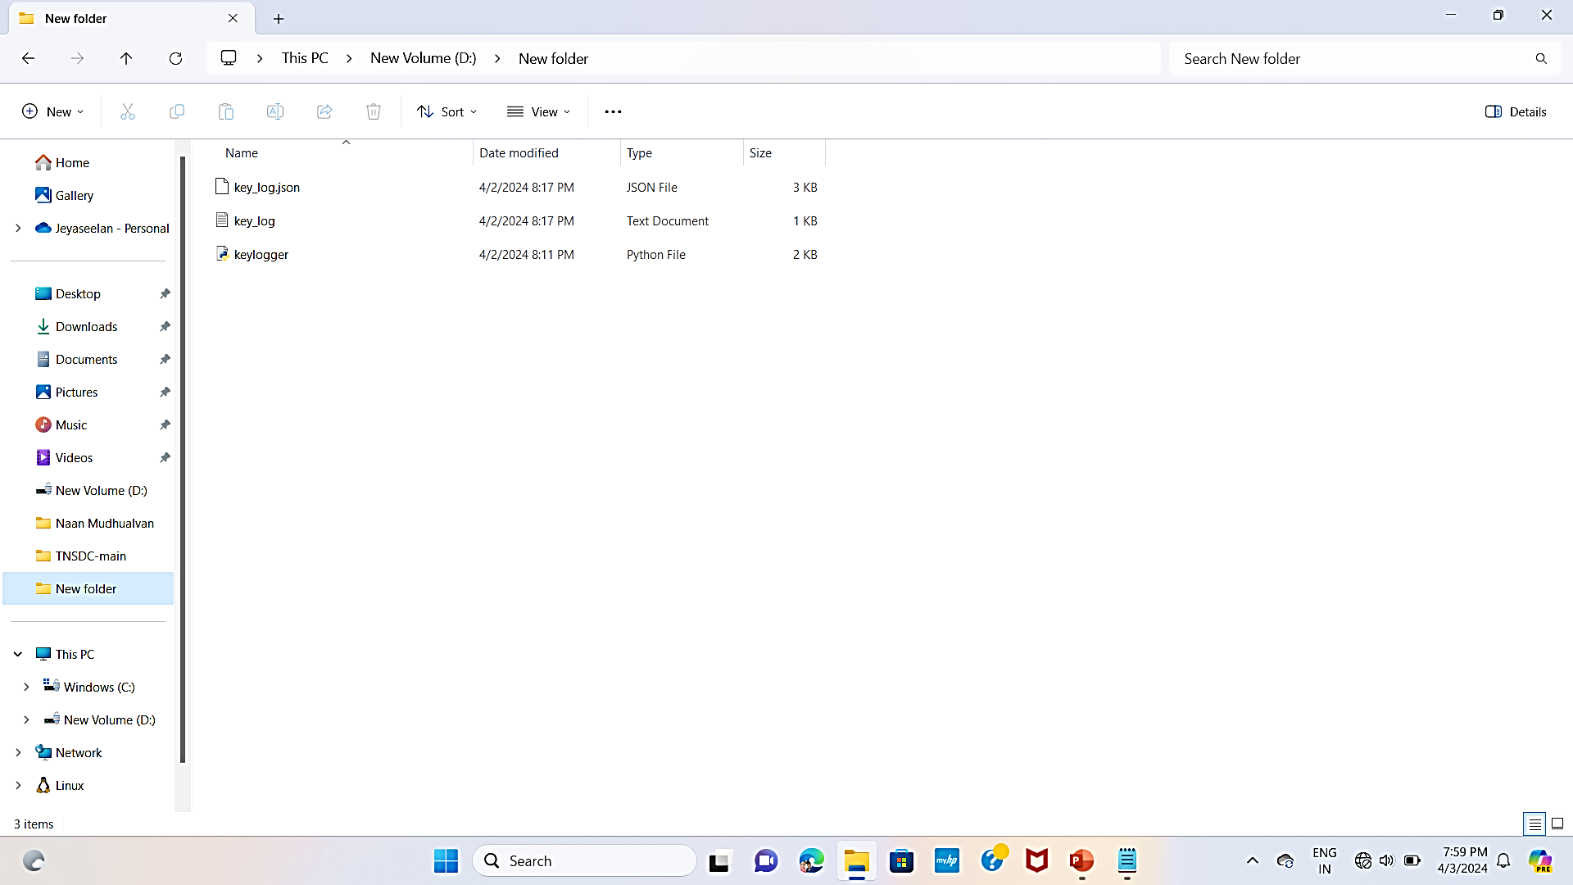

OUTPUT

Slide 17
protection
Monitoring software and antivirus software can also keep track of a system's health and help prevent keyloggers.
Extra precautions include using a security token as part of two-factor authentication to ensure an attacker cannot use a stolen password alone to log in to a user's account, or using an onscreen keyboard and voice-to-text software to circumvent using a physical keyboard.
Application allowlisting can also be used to allow only documented, authorized programs to run on a system.

Slide 18
protection
While visual inspection can identify hardware keyloggers, it is impractical and time-consuming to implement on a large scale. Instead, using a firewall can provide better protection by discovering and preventing the transfer of keystroke information from the victim's keyboard to the attacker.
Password managers that automatically fill in username and password fields can help protect against keyloggers.

Slide 19
Solution
Use antivirus software: Antivirus
software can identify and remove malware faster than you can manually, and is the gold standard for preventing keyloggers.
• Update your system: System updates to your operating system and applications keep malicious users from exploiting known issues.
• Use a password manager: A password manager stores passwords from all your accounts so you only need to remember the master password.
• Use two-factor authentication: Two-
factor identification adds an additional step when logging into an account or device, requiring a temporary PIN or fingerprint to verify that you own the
account you're logging into.
• Always read your terms of
service: Before accepting any terms of service or contracts, make sure you know what you're agreeing to.
• Keep your passwords long and complex: Avoid using the same password for different services.

Slide 20
Future scope
Enhanced security solution
Behavioral analysis
Legitimate use cases
Anti-fraud measures
Integration with AI and machine learning
IOT security
Privacy concerns

Slide 21
Result
In today's digital age, keyloggers are a major cybersecurity concern. These stealthy software tools silently record keystrokes on users' computers, capturing sensitive information like passwords and credit card details without their knowledge. This poses serious risks such as identity theft and financial loss. Despite being hard to detect, individuals and organizations can mitigate this threat by using robust antivirus software, practicing good security habits, and employing advanced security measures like endpoint detection and response solutions

Slide 22
Conclusion
The proliferation of keyloggers in today's digital landscape poses a significant threat to individuals and organizations alike. These stealthy software tools operate covertly, capturing sensitive information such as passwords and credit card details without users' knowledge, potentially leading to identity theft, financial loss, and privacy breaches. To mitigate this risk, it is essential for individuals and organizations to employ robust cybersecurity measures, including using reputable antivirus software, practicing good security habits, and implementing advanced security solutions like endpoint detection and response. By remaining vigilant and proactive, we can better protect ourselves and our data in the face of evolving cybersecurity threats.

Slide 23
THANK YOU

